Slide 1
Dialog-to-Action: Conversational Question Answering Over a Large-Scale Knowledge Base
Daya Guo, Duyu Tang, Nan Duan, Ming Zhou, Jian Yin
Sun Yat-sen University
Microsoft Research Asia
NIPS 2018

Slide 2
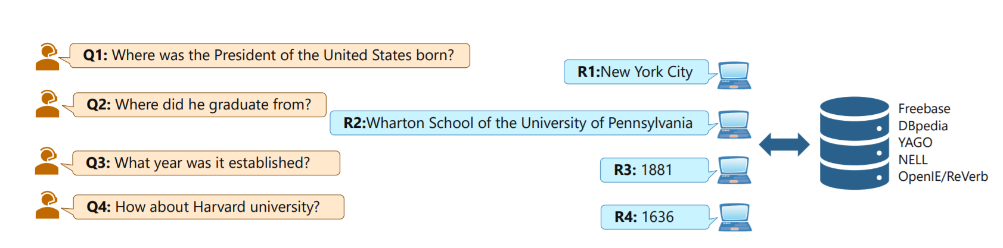
Motivation
KBQA + semantic parsing in conversational question answering

Slide 3
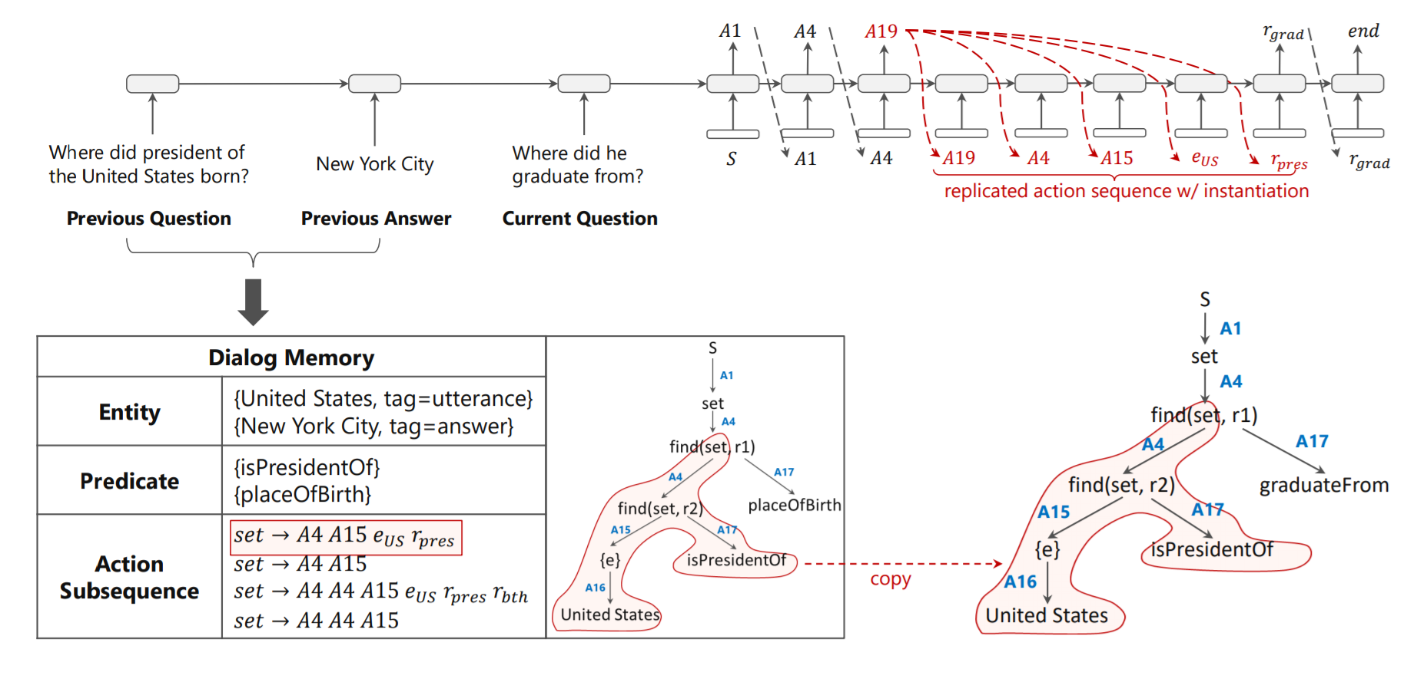
Model
Seq2seq to predict action sequence

Slide 4
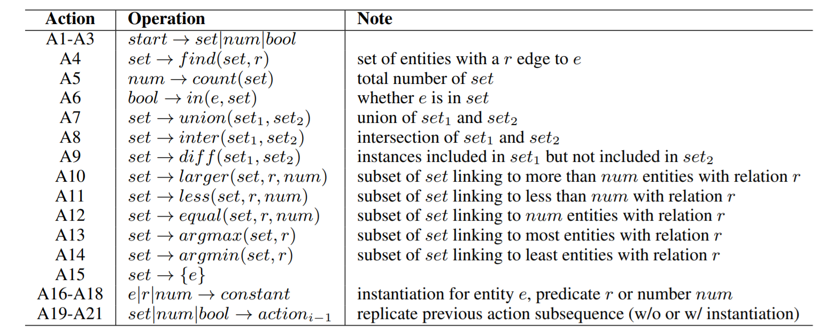
Action Set
Grammar-guided decoding

Slide 5
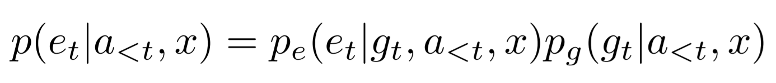
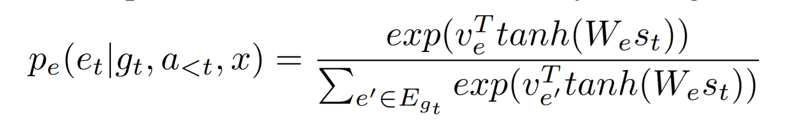
Instantiation
Used when there is need to instantiate entity, predicate and number
Entity - Prev question, prev answer, current question
Predicate - Prev question, current question
Number - Current answer

Slide 6
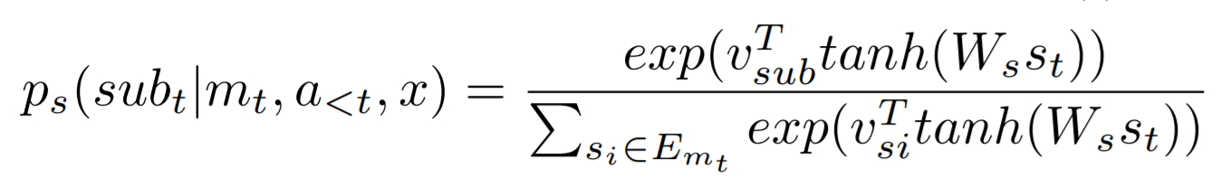
Replication
Used for non-instantiation action
Parse previous action sequence into action trees
Enumerate all subtrees to construct a sequence candidate sets

Slide 7
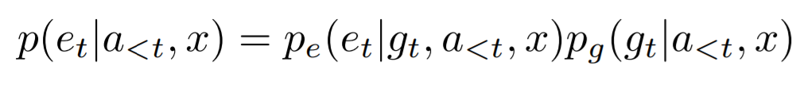
KBQA
Linking entities: Treated as sequence labeling(BiGRU)
Allow instantiation
Predicates: Treated as a ranking problem based on similarity

Slide 8
Training/Inference
Generate action sequence for each sample using breadth first search
Beam search at inference stage

Slide 9
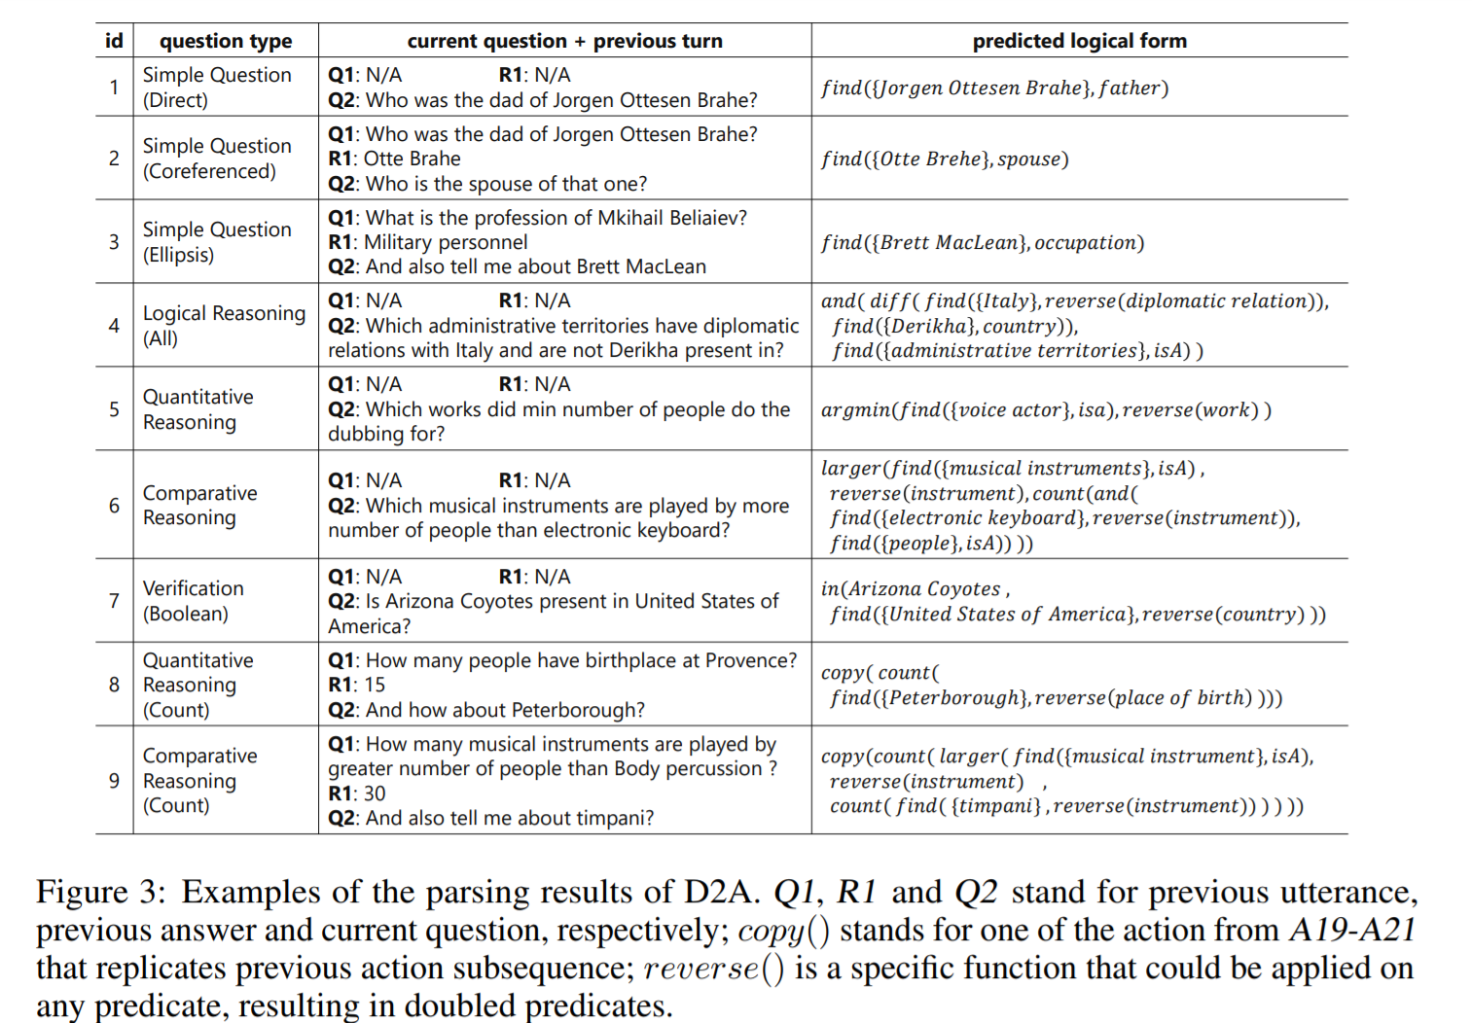
CSQA overview

Slide 10
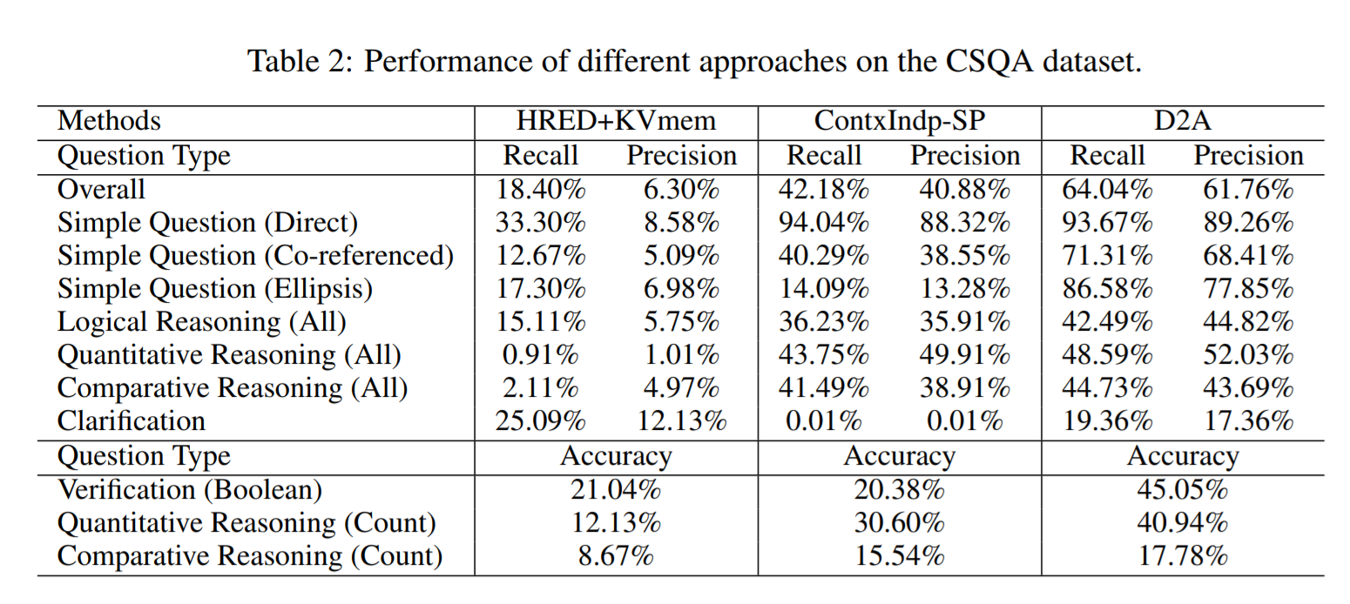
Experiment

Slide 11
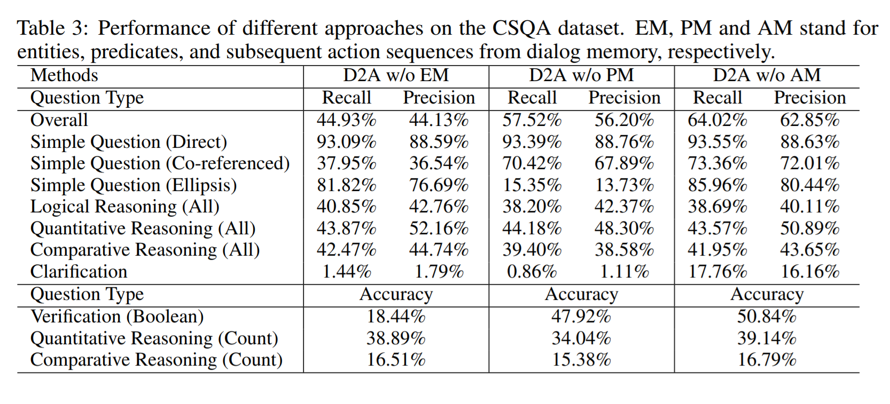
Experiment

Slide 12
Joint Multilingual Supervision for Cross-lingual Entity Linking
Shyam Upadhyay, Nitish Gupta, Dan Roth
University of Pennsylvania
EMNLP 2018

Slide 13
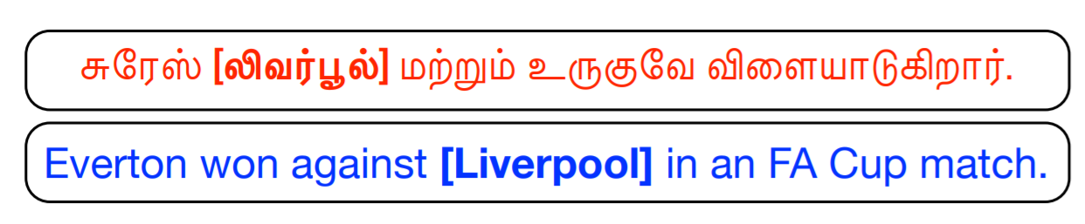
Motivation
Augment the limited supervision in the target language with additional supervision from a high-resource language
Train a single entity linking model for multiple languages, improving upon individually trained models for each language

Slide 14
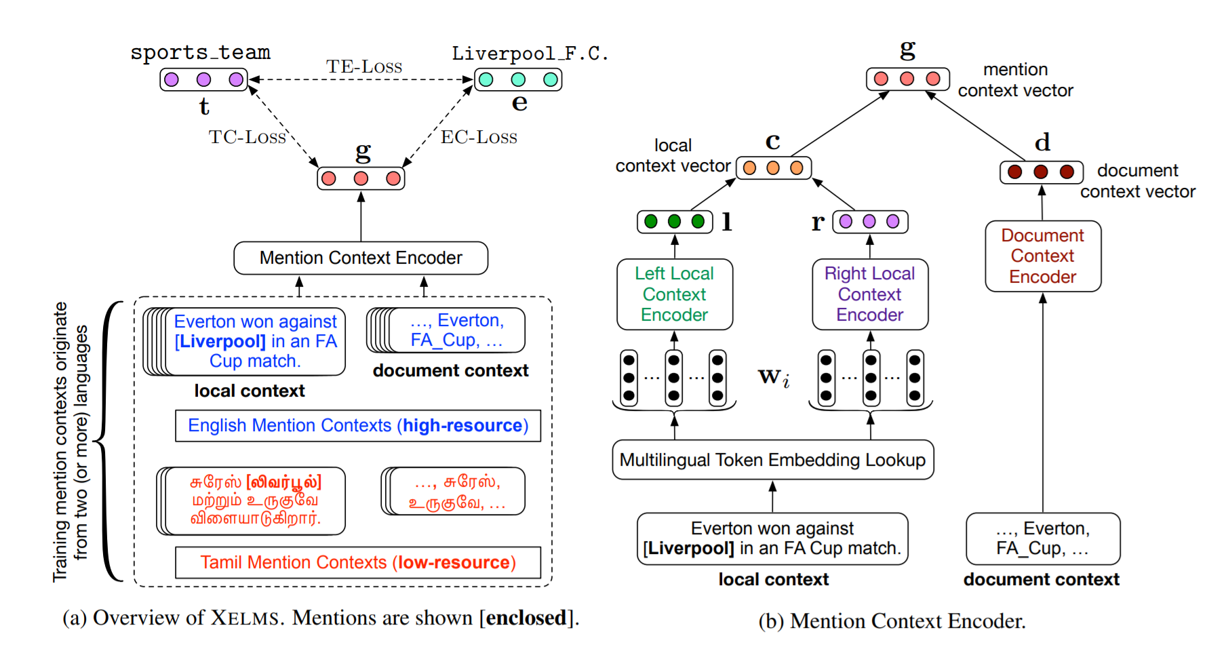

Slide 15
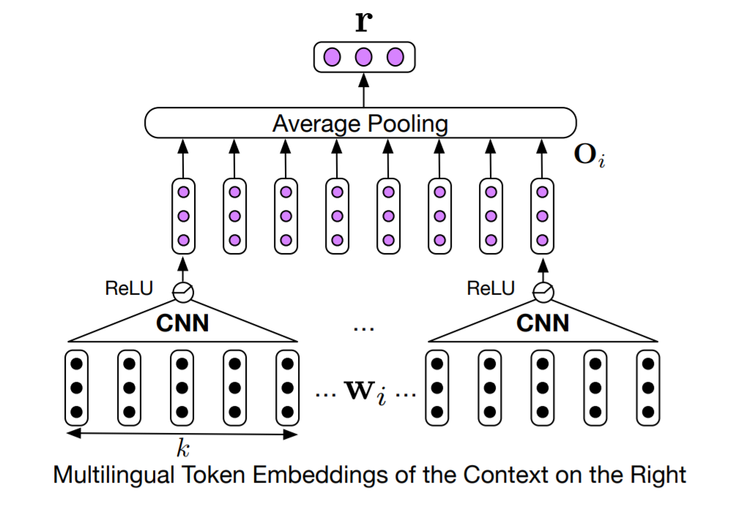
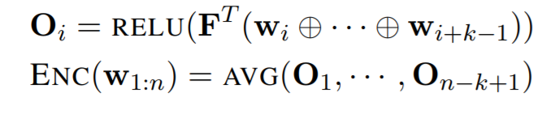
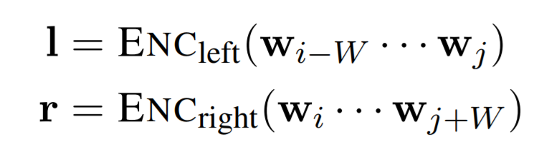
Context Representation - Mention Context
FastText with dictionary for translation
CNN for convolving left and right context

Slide 16
Context Representation - Document Context
Encode all other mentions appear in a document using a feed forward network
Help disambiguation

Slide 17
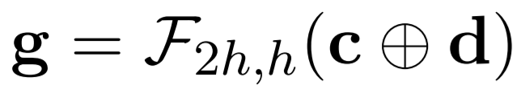
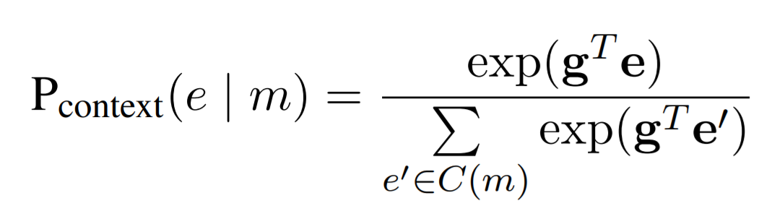
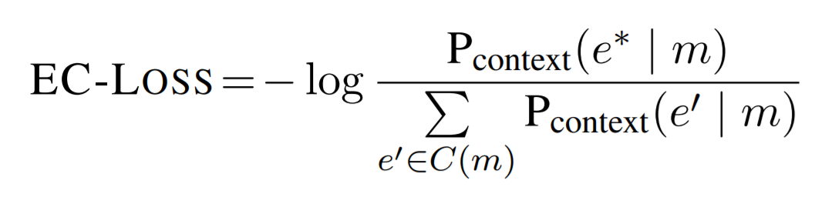
Context Representation
Final representation
Conditional probability
Conditional loss

Slide 18
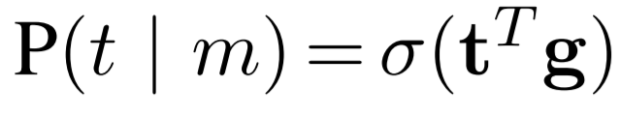
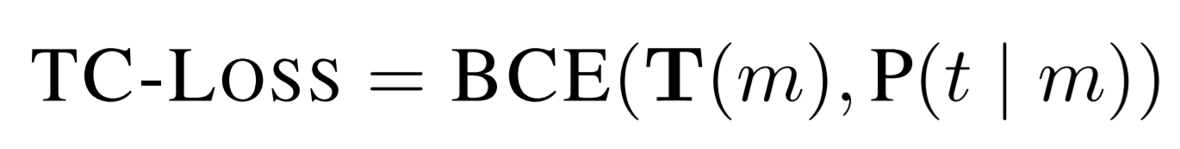
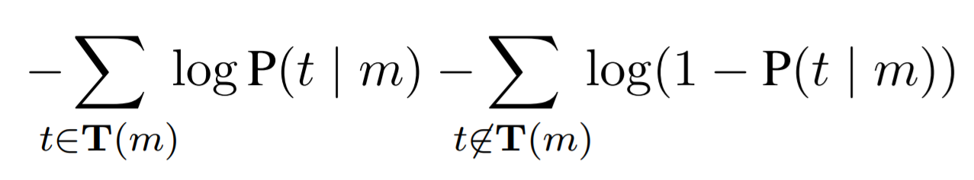
Type Info and Type Loss
Predict mention type using mention context and type embedding
Training using Type-Context Loss

Slide 19
Entity Type and Entity Loss
Similarly, define a Type-Context Loss using entity embedding

Slide 20
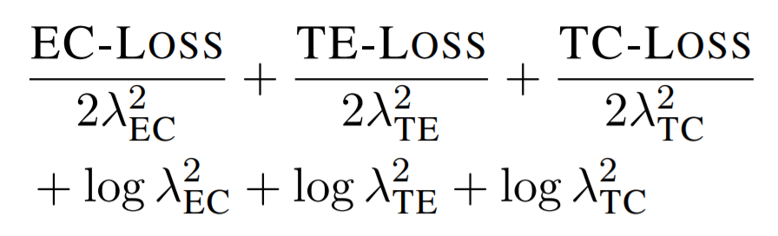
Training
Loss
Mentions from different languages are mixed using inverse-ratio mini-batch mixing strategy
Overall size of language a:b -> Size of mini-batch 1/a : 1/b

Slide 21
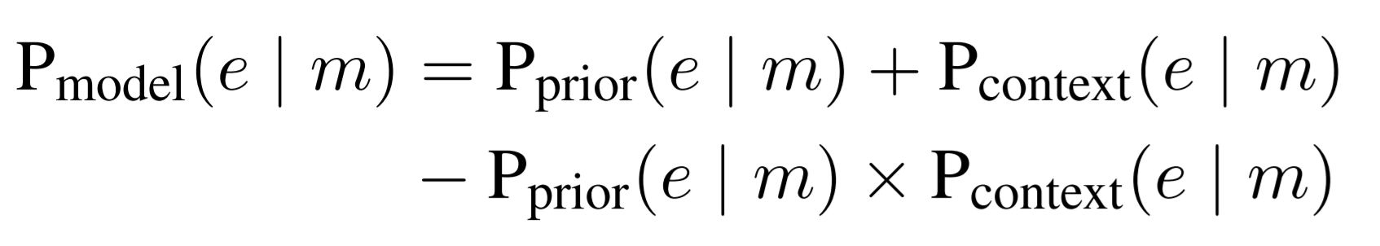
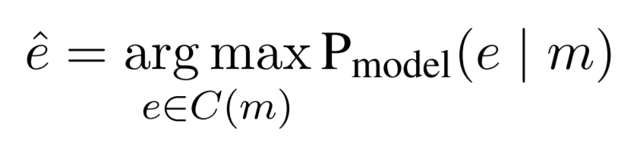
Inference
Candidate generations
Generating candidate based on 2-level lexicon
Lexicon built purely from Wikipedia hyperlinks
Crosswikis leads to much worse result in this task
Final entity probability is union of context probability and prior probability

Slide 22
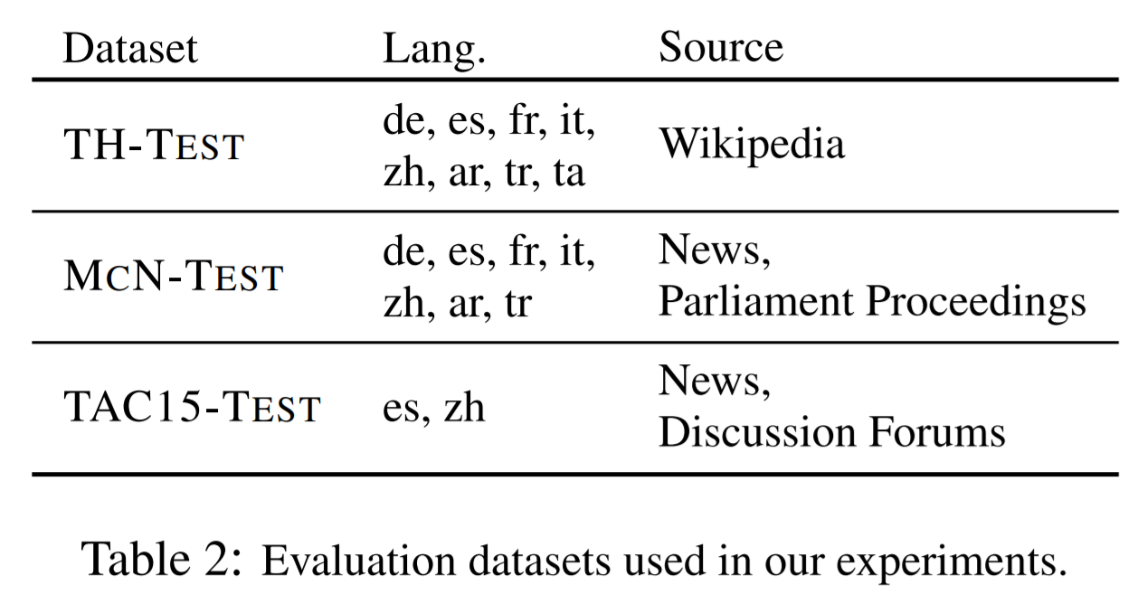
Experiment

Slide 23
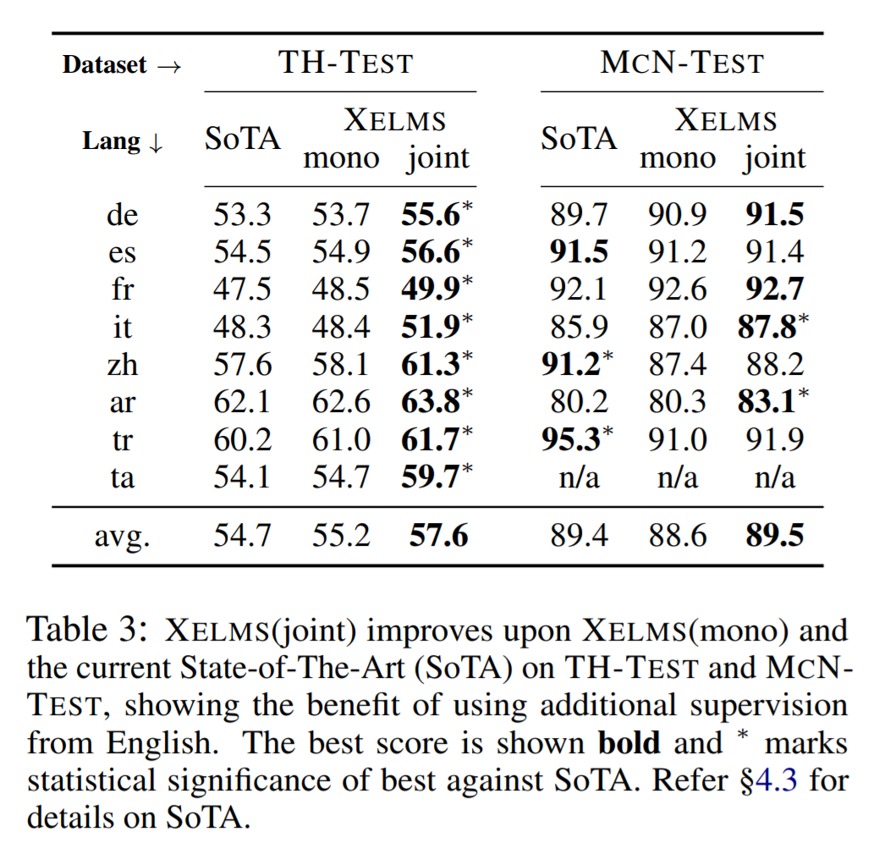
Experiment

Slide 24
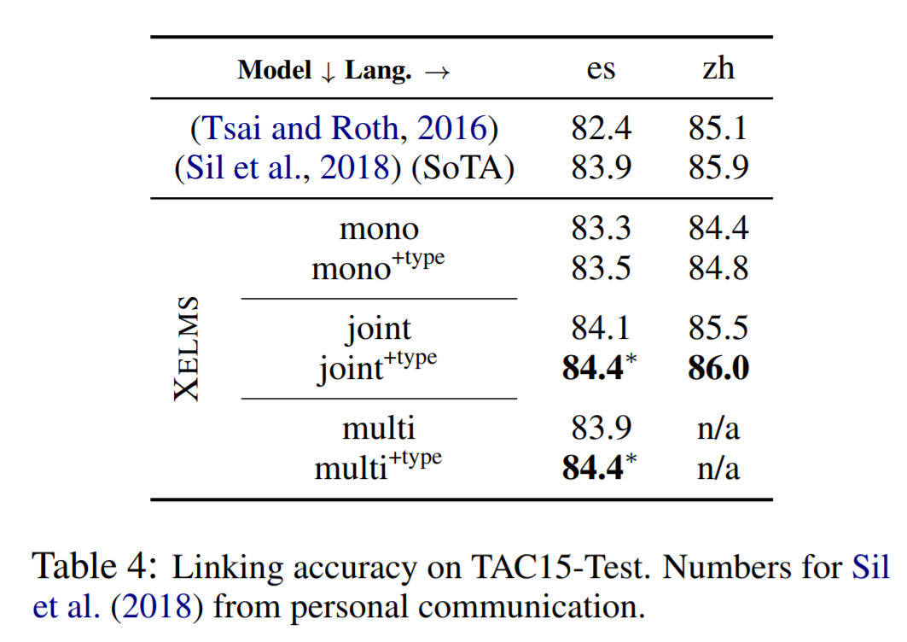
Experiment

Slide 25
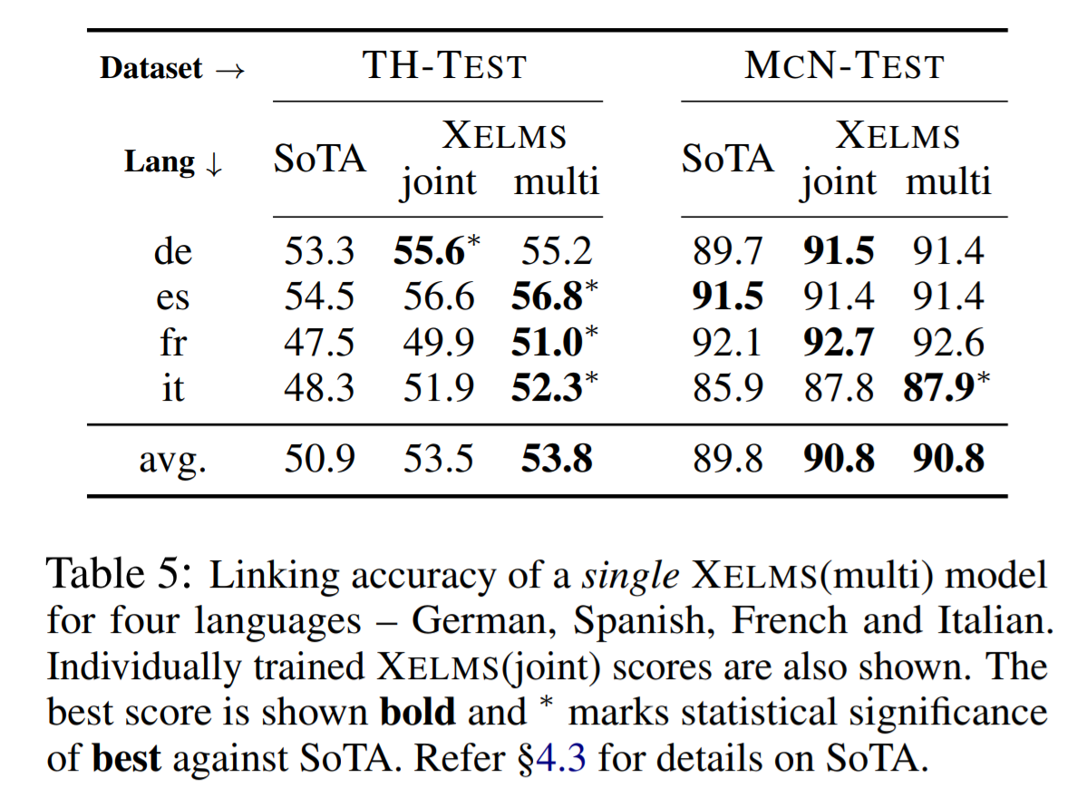
Experiment

Slide 26
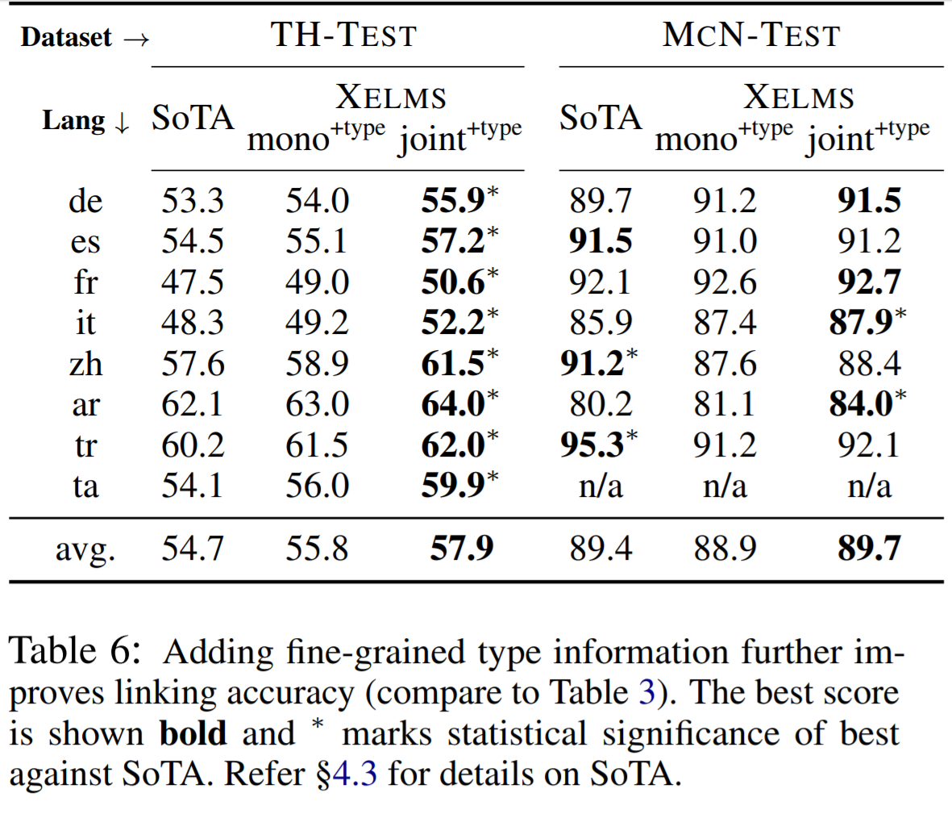
Experiment

Slide 27
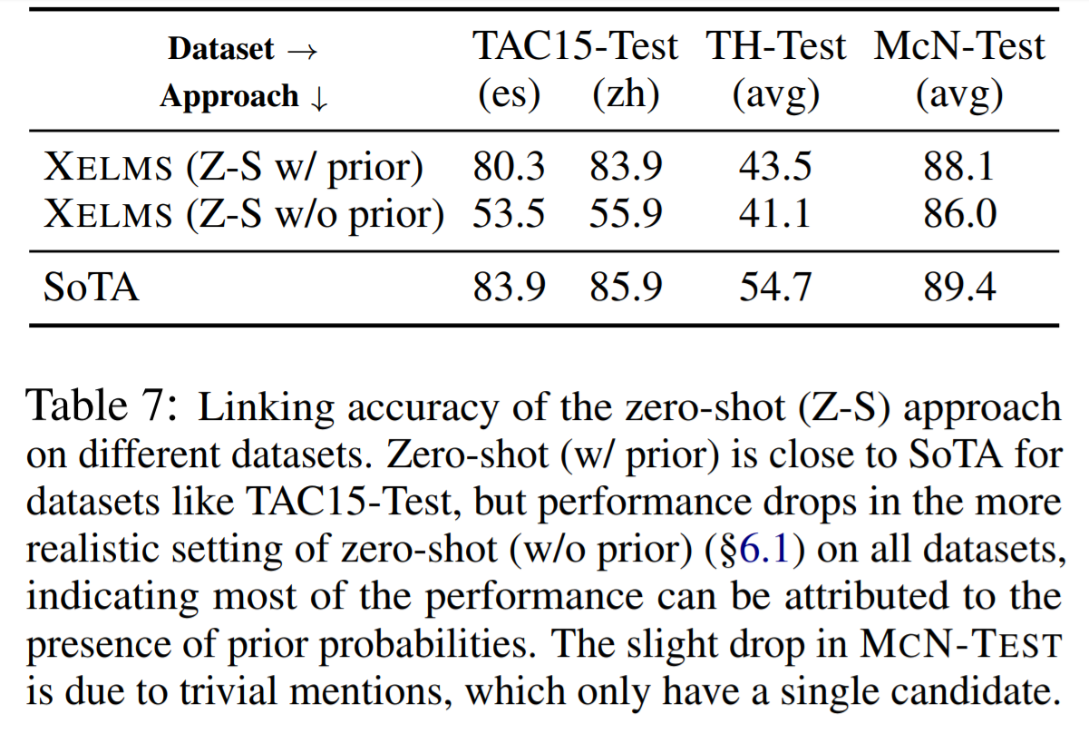
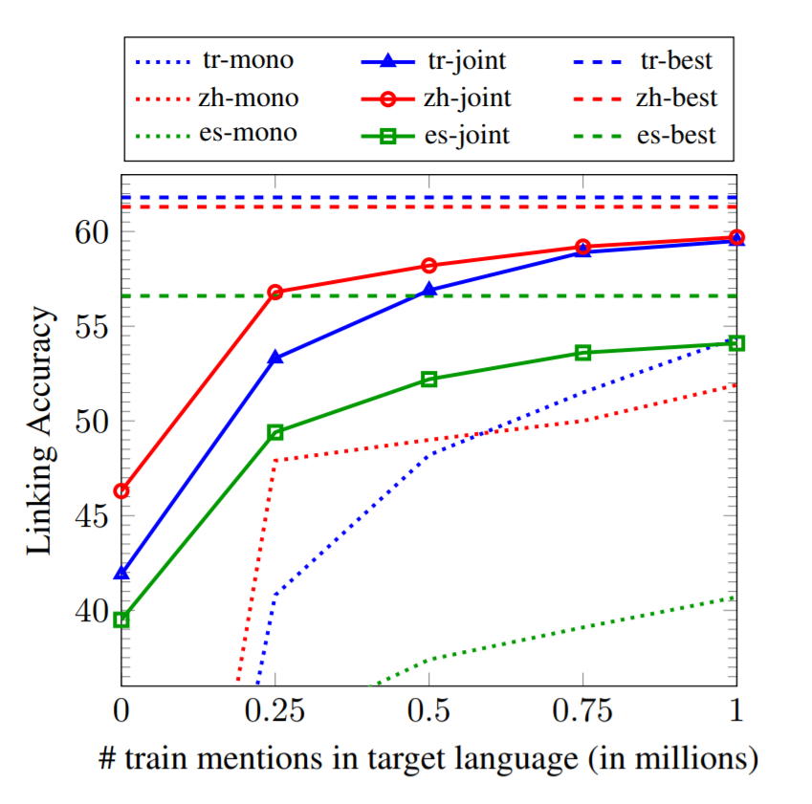
Low Resource/Zero Shot

